Slide 1
02/08/22
A0183 A0184 A0185 A0186 A0187 A0188 A0189 A0190 A0191 A0192 A0193 A0194 A0195 A0196 A0197 A0198 A0199 A0200 A0201 A0202 A0203 A0204 A0205 A0206 A0207 A0208 A0209 A0210 A0211 3427 3428 3429 3439 3440 3443 3444 3445 3446 3447 3448 3449 3450 3451 3452 3453 3454 3455 3456 3457 3458 3459 3460 3461 3462 H2O
ASM WT~270bp KO~520bp
ASM WT~270bp KO~520bp
Nlrp3 WT~248bp KO~430bp
Tie2-Cre 250bp Int. 324bp
F1R 370bp
F2R WT-410bp flox-450bp

Slide 2
3/4/22
A0186 A0187 A0191 A0193 2814 A0212 A0213 A0214 A0215 A0216 A0217 A0218 A0219 A0220 A0221 A0222 A0223 A0224 A0225 FA088 FA089 H2O ASM WT~270bp KO~520bp
ASM WT~270bp KO~520bp
Nlrp3 WT~248bp KO~430bp
Tie2-Cre 250bp Int. 324bp
F1R 370bp
F2R WT-410bp flox-450bp

Slide 3
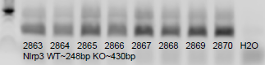
5/14/22
2835 2836 2837 2838 2839 2840 2841 2842 2843 2844 2845 2846 2847 2848 2849 2850 2851 2852 2853 2854 2855 2856 2857 2858 2859 2860 2861 2862 2863 2864 2865 2866 2867 2868 2869 2870 H2O
Nlrp3 WT~248bp KO~430bp
ASM WT~270bp KO~520bp
Nlrp3 WT~248bp KO~430bp
Tie2-Cre 250bp Int. 324bp
F1R 370bp
F2R WT-410bp flox-450bp

Slide 4
02/08/22
ASM WT~270bp KO~520bp
Nlrp3 WT~248bp KO~430bp
Tie2-Cre 250bp Int. 324bp
F1R 370bp
F2R WT-410bp flox-450bp

Slide 5
02/08/22
ASM WT~270bp KO~520bp
Nlrp3 WT~248bp KO~430bp
Tie2-Cre 250bp Int. 324bp
F1R 370bp
F2R WT-410bp flox-450bp

Slide 6
02/08/22
ASM WT~270bp KO~520bp
Nlrp3 WT~248bp KO~430bp
Tie2-Cre 250bp Int. 324bp
F1R 370bp
F2R WT-410bp flox-450bp

Slide 7
02/08/22
ASM WT~270bp KO~520bp
Nlrp3 WT~248bp KO~430bp
Tie2-Cre 250bp Int. 324bp
F1R 370bp
F2R WT-410bp flox-450bp

Slide 8
02/08/22
ASM WT~270bp KO~520bp
Nlrp3 WT~248bp KO~430bp
Tie2-Cre 250bp Int. 324bp
F1R 370bp
F2R WT-410bp flox-450bp

Slide 9
02/08/22
ASM WT~270bp KO~520bp
Nlrp3 WT~248bp KO~430bp
Tie2-Cre 250bp Int. 324bp
F1R 370bp
F2R WT-410bp flox-450bp

Slide 10
02/08/22
ASM WT~270bp KO~520bp
Nlrp3 WT~248bp KO~430bp
Tie2-Cre 250bp Int. 324bp
F1R 370bp
F2R WT-410bp flox-450bp

Slide 11
02/08/22
ASM WT~270bp KO~520bp
Nlrp3 WT~248bp KO~430bp
Tie2-Cre 250bp Int. 324bp
F1R 370bp
F2R WT-410bp flox-450bp

Slide 12
02/08/22
ASM WT~270bp KO~520bp
Nlrp3 WT~248bp KO~430bp
Tie2-Cre 250bp Int. 324bp
F1R 370bp
F2R WT-410bp flox-450bp

Slide 13
02/08/22
ASM WT~270bp KO~520bp
Nlrp3 WT~248bp KO~430bp
Tie2-Cre 250bp Int. 324bp
F1R 370bp
F2R WT-410bp flox-450bp

Slide 14
02/08/22
ASM WT~270bp KO~520bp
Nlrp3 WT~248bp KO~430bp
Tie2-Cre 250bp Int. 324bp
F1R 370bp
F2R WT-410bp flox-450bp

Slide 15
02/08/22
ASM WT~270bp KO~520bp
Nlrp3 WT~248bp KO~430bp
Tie2-Cre 250bp Int. 324bp
F1R 370bp
F2R WT-410bp flox-450bp

Slide 16
02/08/22
ASM WT~270bp KO~520bp
Nlrp3 WT~248bp KO~430bp
Tie2-Cre 250bp Int. 324bp
F1R 370bp
F2R WT-410bp flox-450bp

Slide 17
02/08/22
ASM WT~270bp KO~520bp
Nlrp3 WT~248bp KO~430bp
Tie2-Cre 250bp Int. 324bp
F1R 370bp
F2R WT-410bp flox-450bp

Slide 18
02/08/22
ASM WT~270bp KO~520bp
Nlrp3 WT~248bp KO~430bp
Tie2-Cre 250bp Int. 324bp
F1R 370bp
F2R WT-410bp flox-450bp

Slide 19
02/08/22
ASM WT~270bp KO~520bp
Nlrp3 WT~248bp KO~430bp
Tie2-Cre 250bp Int. 324bp
F1R 370bp
F2R WT-410bp flox-450bp

Slide 20
02/08/22
ASM WT~270bp KO~520bp
Nlrp3 WT~248bp KO~430bp
Tie2-Cre 250bp Int. 324bp
F1R 370bp
F2R WT-410bp flox-450bp

Slide 21
02/08/22
ASM WT~270bp KO~520bp
Nlrp3 WT~248bp KO~430bp
Tie2-Cre 250bp Int. 324bp
F1R 370bp
F2R WT-410bp flox-450bp

Slide 22
02/08/22
ASM WT~270bp KO~520bp
Nlrp3 WT~248bp KO~430bp
Tie2-Cre 250bp Int. 324bp
F1R 370bp
F2R WT-410bp flox-450bp

Slide 23
02/08/22
ASM WT~270bp KO~520bp
Nlrp3 WT~248bp KO~430bp
Tie2-Cre 250bp Int. 324bp
F1R 370bp
F2R WT-410bp flox-450bp

Slide 24
02/08/22
ASM WT~270bp KO~520bp
Nlrp3 WT~248bp KO~430bp
Tie2-Cre 250bp Int. 324bp
F1R 370bp
F2R WT-410bp flox-450bp

Slide 25
02/08/22
ASM WT~270bp KO~520bp
Nlrp3 WT~248bp KO~430bp
Tie2-Cre 250bp Int. 324bp
F1R 370bp
F2R WT-410bp flox-450bp

Slide 26
02/08/22
ASM WT~270bp KO~520bp
Nlrp3 WT~248bp KO~430bp
Tie2-Cre 250bp Int. 324bp
F1R 370bp
F2R WT-410bp flox-450bp

Slide 27
02/08/22
ASM WT~270bp KO~520bp
Nlrp3 WT~248bp KO~430bp
Tie2-Cre 250bp Int. 324bp
F1R 370bp
F2R WT-410bp flox-450bp

Slide 28
02/08/22
ASM WT~270bp KO~520bp
Nlrp3 WT~248bp KO~430bp
Tie2-Cre 250bp Int. 324bp
F1R 370bp
F2R WT-410bp flox-450bp

Slide 29
02/08/22
ASM WT~270bp KO~520bp
Nlrp3 WT~248bp KO~430bp
Tie2-Cre 250bp Int. 324bp
F1R 370bp
F2R WT-410bp flox-450bp

Slide 30
02/08/22
ASM WT~270bp KO~520bp
Nlrp3 WT~248bp KO~430bp
Tie2-Cre 250bp Int. 324bp
F1R 370bp
F2R WT-410bp flox-450bp

Slide 31
1/24/21
2021 End
FA008 FA009 FA010 4.03
A0040 A0041 A0042 4.10
1850 1851 1856 5.00
F509 F510 F511 4.90
ASM WT~270bp KO~520bp
Nlrp3 WT~248bp KO~430bp
Tie2-Cre 250bp Int. 324bp
F1R 370bp
F2R WT-410bp flox-450bp

Slide 32
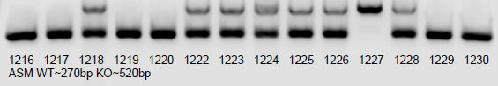
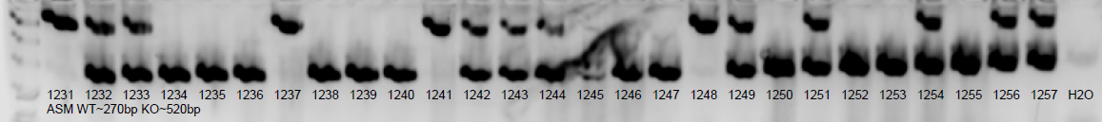
1/8/20
1216 1217 1218 1219 1220 1222 1223 1224 1225 1226 1227 1228 1229 1230
ASM WT~270bp KO~520bp
1231 1232 1233 1234 1235 1236 1237 1238 1239 1240 1241 1242 1243 1244 1245 1246 1247 1248 1249 1250 1251 1252 1253 1254 1255 1256 1257 H2O
ASM WT~270bp KO~520bp
ASM WT~270bp KO~520bp
Nlrp3 WT~248bp KO~430bp

Slide 33
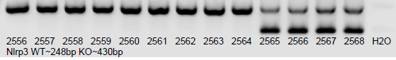
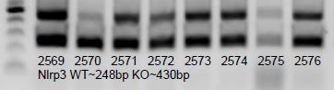
1/8/20
2556 2557 2558 2559 2560 2561 2562 2563 2564 2565 2566 2567 2568 2569 2570 2571 2572 2573 2574 2575 2576 H2O
Nlrp3 WT~248bp KO~430bp
ASM WT~270bp KO~520bp
Nlrp3 WT~248bp KO~430bp

Slide 34
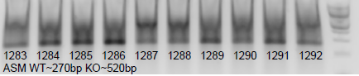
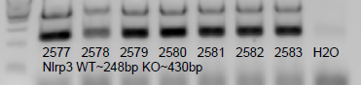
1/24/20
1246 1247 1258 1259 1260 1261 1262 1263 1264 1265 1266 1267 1268 1269 1270 1271 1272 1273 1274 1275 1276 1277 1278 1279 1280 1281 1282 1283 1284 1285 1286 1287 1288 1289 1290 1291 1292 H2O
ASM WT~270bp KO~520bp
ASM WT~270bp KO~520bp
Nlrp3 WT~248bp KO~430bp

Slide 35
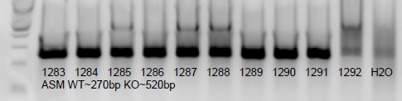
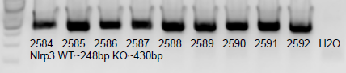
1/29/20
1283 1284 1285 1286 1287 1288 1289 1290 1291 1292 H2O
ASM WT~270bp KO~520bp
2584 2585 2586 2587 2588 2589 2590 2591 2592 H2O
Nlrp3 WT~248bp KO~430bp
ASM WT~270bp KO~520bp
Nlrp3 WT~248bp KO~430bp

Slide 36
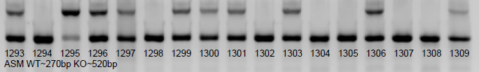
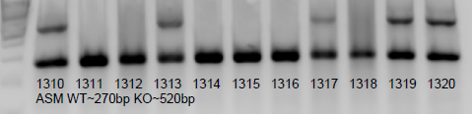
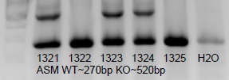
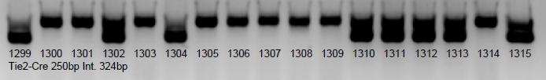
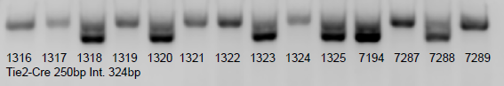
2/7/20
1293 1294 1295 1296 1297 1298 1299 1300 1301 1302 1303 1304 1305 1306 1307 1308 1309 1310 1311 1312 1313 1314 1315 1316 1317 1318 1319 1320 1321 1322 1323 1324 1325 H2O
ASM WT~270bp KO~520bp
ASM WT~270bp KO~520bp
Nlrp3 WT~248bp KO~430bp

Slide 37
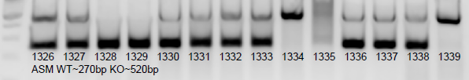
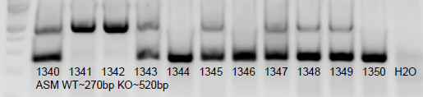
2/26/20
Redo from 2/6
1299 1306 1309 1310 1313 1317 1319 1320 1323 1324 1326 1327 1328 1329 1330 1331 1332 1333 1334 1335 1336 1337 1338 1339 1340 1341 1342 1343 1344 1345 1346 1347 1348 1349 1350 H2O
ASM WT~270bp KO~520bp
ASM WT~270bp KO~520bp
Nlrp3 WT~248bp KO~430bp

Slide 38
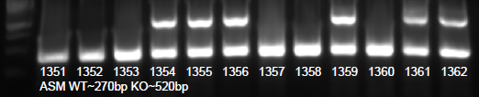
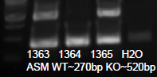
3/6/20
1351 1352 1353 1354 1355 1356 1357 1358 1359 1360 1361 1362 1363 1364 1365 H2O
ASM WT~270bp KO~520bp
ASM WT~270bp KO~520bp
Nlrp3 WT~248bp KO~430bp

Slide 39
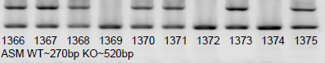
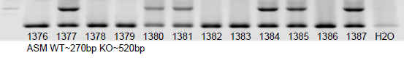
3/12/20
1366 1367 1368 1369 1370 1371 1372 1373 1374 1375 1376 1377 1378 1379 1380 1381 1382 1383 1384 1385 1386 1387 H2O
ASM WT~270bp KO~520bp
1351 1352 1353 1354 1355 1356 1357 1358 1359 1360 1361 1362 1363 1364 1365 3205 3206 3207 3208 9108 9109 9110 H2O
F2R WT-410bp flox-450bp
ASM WT~270bp KO~520bp
Nlrp3 WT~248bp KO~430bp
Tie2-Cre 250bp Int. 324bp
F1R 370bp
F2R WT-410bp flox-450bp

Slide 40
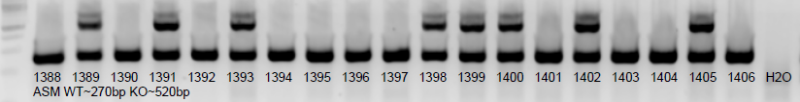
3/20/20
1388 1389 1390 1391 1392 1393 1394 1395 1396 1397 1398 1399 1400 1401 1402 1403 1404 1405 1406 3155 3156 3157 3158 3159 3160 H2O 3161 3162 3163 3164 3165 3166 3170b 3171b 3172b3173b 3170a 3171a 3172a 3173a 3209 3210 H2O
F1R 370bp
ASM WT~270bp KO~520bp
Nlrp3 WT~248bp KO~430bp
Tie2-Cre 250bp Int. 324bp
F1R 370bp
F2R WT-410bp flox-450bp

Slide 41
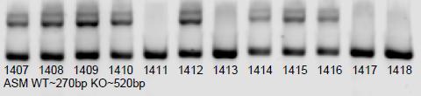
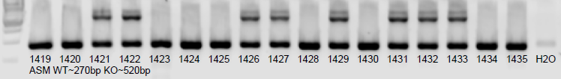
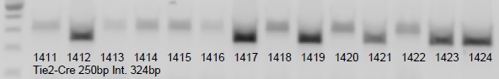
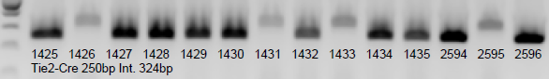
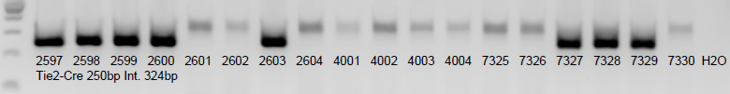
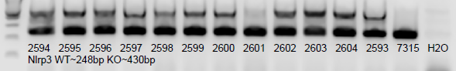
3/26/20
1407 1408 1409 1410 1411 1412 1413 1414 1415 1416 1417 1418 1419 1420 1421 1422 1423 1424 1425 1426 1427 1428 1429 1430 1431 1432 1433 1434 1435 H2O
ASM WT~270bp KO~520bp
2594 2595 2596 2597 2598 2599 2600 2601 2602 2603 2604 2593 7315 H2O
Nlrp3 WT~248bp KO~430bp
ASM WT~270bp KO~520bp
Nlrp3 WT~248bp KO~430bp
Tie2-Cre 250bp Int. 324bp
F1R 370bp
F2R WT-410bp flox-450bp

Slide 42
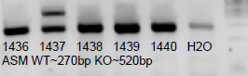
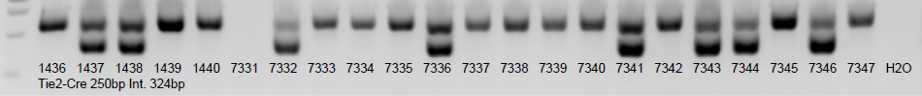
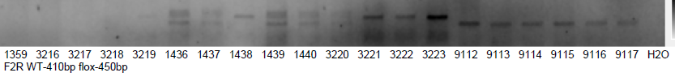
4/7/20
1359 3216 3217 3218 3219 1436 1437 1438 1439 1440 3220 3221 3222 3223 9112 9113 9114 9115 9116 9117 7331 7332 7333 7334 7335 7336 7337 7338 7339 7340 7341 7342 7343 7344 7345 7346 7347 H2O
F2R WT-410bp flox-450bp
ASM WT~270bp KO~520bp
Nlrp3 WT~248bp KO~430bp
Tie2-Cre 250bp Int. 324bp
F1R 370bp
F2R WT-410bp flox-450bp

Slide 43
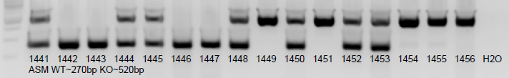
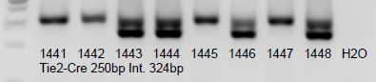
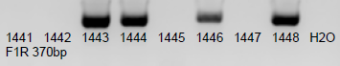
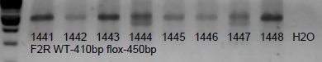
4/17/20
1441 1442 1443 1444 1445 1446 1447 1448 1449 1450 1451 1452 1453 1454 1455 1456 H2O
ASM WT~270bp KO~520bp
ASM WT~270bp KO~520bp
Nlrp3 WT~248bp KO~430bp
Tie2-Cre 250bp Int. 324bp
F1R 370bp
F2R WT-410bp flox-450bp

Slide 44
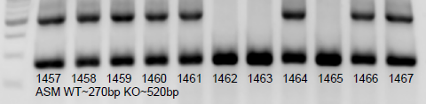
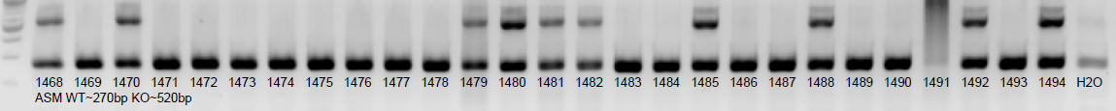
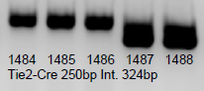
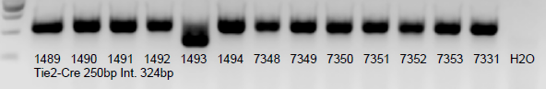
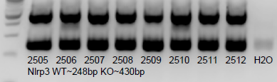
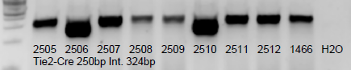
4/22/20
1457 1458 1459 1460 1461 1462 1463 1464 1465 1466 1467 1468 1469 1470 1471 1472 1473 1474 1475 1476 1477 1478 1479 1480 1481 1482 1483 1484 1485 1486 1487 1488 1489 1490 1491 1492 1493 1494 H2O 1359
ASM WT~270bp KO~520bp
2605 2606 2607 2608 2609 2610 2611 2612 H2O
Nlrp3 WT~248bp KO~430bp
ASM WT~270bp KO~520bp
Nlrp3 WT~248bp KO~430bp
Tie2-Cre 250bp Int. 324bp
F1R 370bp
F2R WT-410bp flox-450bp

Slide 45
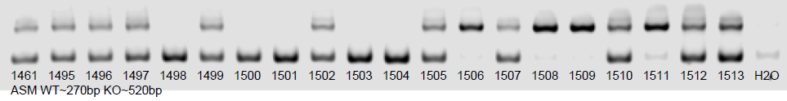
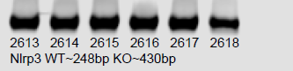
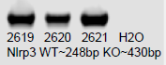
5/4/20
1461 1495 1496 1497 1498 1499 1500 1501 1502 1503 1504 1505 1506 1507 1508 1509 1510 1511 1512 1513 7354 7355 7356 9118 9119 9120 9121 H2O
Tie2-Cre 250bp Int. 324bp
2613 2614 2615 2616 2617 2618 2619 2620 2621 H2O
Nlrp3 WT~248bp KO~430bp
ASM WT~270bp KO~520bp
Nlrp3 WT~248bp KO~430bp
Tie2-Cre 250bp Int. 324bp
F1R 370bp
F2R WT-410bp flox-450bp

Slide 46
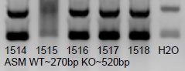
5/11/20
1514 1515 1516 1517 1518 3228 3229 3230 3231 3232 3233 3234 3235 9122 9123 9124 9125 9126 9127 9128 9129 9130 9131 H2O
MER 287bp Int. 180bp
ASM WT~270bp KO~520bp
Nlrp3 WT~248bp KO~430bp
Tie2-Cre 250bp Int. 324bp
F1R 370bp
F2R WT-410bp flox-450bp

Slide 47
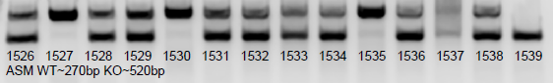
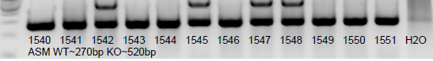
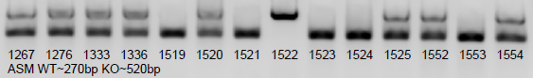
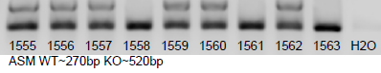
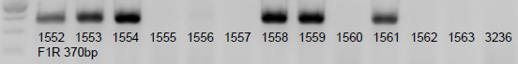
1267 1276 1333 1336 1519 1520 1521 1522 1523 1524 1525 1526 1527 1528 1529 1530 1531 1532 1533 1534 1535 1536 1537 1538 1539 1540 1541 1542 1543 1544 1545 1546 1547 1548 1549 1550 1551 1552 1553 1554 1555 1556 1557 1558 1559 1560 1561 1562 1563 H2O
F2R WT-410bp flox-450bp
5/25/20
ASM WT~270bp KO~520bp
Nlrp3 WT~248bp KO~430bp
Tie2-Cre 250bp Int. 324bp
F1R 370bp
F2R WT-410bp flox-450bp

Slide 48
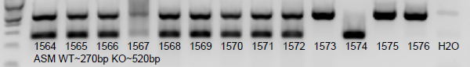



5/27/20
1564 1565 1566 1567 1568 1569 1570 1571 1572 1573 1574 1575 1576 H2O
ASM WT~270bp KO~520bp
2622 2623 2624 2625 2626 2627 2628 2629 2630 2631
Tie2-Cre 250bp Int. 324bp
ASM WT~270bp KO~520bp
Nlrp3 WT~248bp KO~430bp
Tie2-Cre 250bp Int. 324bp
F1R 370bp
F2R WT-410bp flox-450bp

Slide 49





6/5/20
1577 1578 1579 1580 1581 1582 1583 1584 1585 1586 1587 1588 1589 1590 H2O
ASM WT~270bp KO~520bp
2633 2634 2635 2636 2637 2638 2639 2640 H2O
Nlrp3 WT~248bp KO~430bp
ASM WT~270bp KO~520bp
Nlrp3 WT~248bp KO~430bp
Tie2-Cre 250bp Int. 324bp
F1R 370bp
F2R WT-410bp flox-450bp

Slide 50




6/23/20
1591 1592 1593 1594 1595 1596 1597 1598 1599 1600 1601 1602 1603 1604 1605 1606 1607 1608 1609 1610 1611 1612 1613 1614 1615 1616 1617 1618 1619 1620 1621 1622 1623 1624 1625 1626 1627 1628 1629 1630 1631 1632 1633 1634 1635 1636 1637 1638 H2O
ASM WT~270bp KO~520bp
ASM WT~270bp KO~520bp
Nlrp3 WT~248bp KO~430bp
Tie2-Cre 250bp Int. 324bp
F1R 370bp
F2R WT-410bp flox-450bp

Slide 51





6/27/20
1639 1640 1641 1642 1643 1644 1645 1646 H2O
ASM WT~270bp KO~520bp
2640 2641 2642 H2O
Nlrp3 WT~248bp KO~430bp
ASM WT~270bp KO~520bp
Nlrp3 WT~248bp KO~430bp
Tie2-Cre 250bp Int. 324bp
F1R 370bp
F2R WT-410bp flox-450bp

Slide 52







7/11/20
1615 1629 1647 1648 1649 1650 1651 1652 1653 1654 1655 1656 1657 1658 1659 1660 1661 1662 1663 1664 1665 1666 1667 1668 1669 1670 1671 1672 1673 1674 1675 1676 1677 1678 1679 1680 1681 1682 1683 1684 1685 1686 1687 1688 1689 1690 H2O
ASM WT~270bp KO~520bp
2643 2644 2645 2646 2647 H2O
Nlrp3 WT~248bp KO~430bp
ASM WT~270bp KO~520bp
Nlrp3 WT~248bp KO~430bp
Tie2-Cre 250bp Int. 324bp
F1R 370bp
F2R WT-410bp flox-450bp

Slide 53





7/22/20
1691 1692 1693 1694 1695 1696 1697 1698 1699 1700 1701 1702 1703 H2O
ASM WT~270bp KO~520bp
2648 2649 2650 2651 2652 2653 2654 2655 WT H2O
Nlrp3 WT~248bp KO~430bp
ASM WT~270bp KO~520bp
Nlrp3 WT~248bp KO~430bp
Tie2-Cre 250bp Int. 324bp
F1R 370bp
F2R WT-410bp flox-450bp

Slide 54


7/31/20
1659 1679 1704 1705 1706 1607 1708 1709 1710 1711 1712 1713 1714 1715 1716 1717 1718 1719 1720 1721 1722 1723 1724 1725 1726 1727 1728 1729 1730 1731 1732 1733 1734 1735 1736 3246 3247 3261 3262 3263 3264 3265 3266 3267 3268 9166 9167 9168 9169 9170 H2O
F2R WT-410bp flox-450bp
ASM WT~270bp KO~520bp
Nlrp3 WT~248bp KO~430bp
Tie2-Cre 250bp Int. 324bp
F1R 370bp
F2R WT-410bp flox-450bp

Slide 55






8/8/20
1679 1706 1720 1724 1728 1700 1703 1708 1709 1710 1717 1737 1738 1739 1740 1741 1742 1743 1744 1745 1746 1747 1748 1749 1750 1751 1752 1753 1754 1755 1756 1757 H2O
F2R WT-410bp flox-450bp
ASM WT~270bp KO~520bp
Nlrp3 WT~248bp KO~430bp
Tie2-Cre 250bp Int. 324bp
F1R 370bp
F2R WT-410bp flox-450bp

Slide 56



8/18/20
1758 1759 1760 1761 1762 1763 1764 1765 1766 1767 1768 1769 1770 1771 1772 1773 7384 7385 7386 7387 7388 7389 7390 7391 7392 7393 7394 H2O
F2R WT-410bp flox-450bp
ASM WT~270bp KO~520bp
Nlrp3 WT~248bp KO~430bp
Tie2-Cre 250bp Int. 324bp
F1R 370bp
F2R WT-410bp flox-450bp

Slide 57





8/25/20
1766 1774 1775 1776 1777 1778 1779 1780 1781 1782 1783 1784 1785 1786 1787 1788 1789 H2O
ASM WT~270bp KO~520bp
2656 2657 2658 2659 2660 H2O
Nlrp3 WT~248bp KO~430bp
ASM WT~270bp KO~520bp
Nlrp3 WT~248bp KO~430bp
Tie2-Cre 250bp Int. 324bp
F1R 370bp
F2R WT-410bp flox-450bp

Slide 58






9/5/20
1790 1791 1792 1793 1794 1795 1796 1797 1798 1799 1800 1801 1802 1803 1804 1805 1806 1807 1808 1809 1810 1811 1812 1813 1814 1815 1816 1817 1818 1819 1820 1821 1822 1823 1824 1825 1826 1827 1828 1829 H2O
ASM WT~270bp KO~520bp
ASM WT~270bp KO~520bp
Nlrp3 WT~248bp KO~430bp
Tie2-Cre 250bp Int. 324bp
F1R 370bp
F2R WT-410bp flox-450bp

Slide 59







9/19/20
1830 1831 1832 1833 1834 1835 1836 1837 1838 1839 1840 1841 1842 1843 1844 1845 1846 1847 1848 1849 1850 1851 1852 1853 1854 1855 1856 1857 1858 1859 1860 1861 1862 1863 1864 1865 1866 1867 1868 1869 H2O
ASM WT~270bp KO~520bp
2661 2662 2663 2664 2665 H2O
Nlrp3 WT~248bp KO~430bp
ASM WT~270bp KO~520bp
Nlrp3 WT~248bp KO~430bp
Tie2-Cre 250bp Int. 324bp
F1R 370bp
F2R WT-410bp flox-450bp

Slide 60


9/30/20
1870 1871 1872 1873 1874 1875 1876 1877 1878 1879 1880 1881 1882 1883 1884 1885 1886 1887 1888 H2O
ASM WT~270bp KO~520bp
2666 2667 2668 2669 2670 2671 H2O
Nlrp3 WT~248bp KO~430bp
ASM WT~270bp KO~520bp
Nlrp3 WT~248bp KO~430bp
Tie2-Cre 250bp Int. 324bp
F1R 370bp
F2R WT-410bp flox-450bp

Slide 61


10/2/20
1410 1516 1518 1520 1640 1643 H2O
ASM WT~270bp KO~520bp
1831 1832 1833 1834 1835 1836 1840 1841 1843 1844 1845 1847 1850 1851 1853 1854 1856 1859 1861 1862 1882 9122 9126 9158 H2O
F2R WT-410bp flox-450bp
ASM WT~270bp KO~520bp
Nlrp3 WT~248bp KO~430bp
Tie2-Cre 250bp Int. 324bp
F1R 370bp
F2R WT-410bp flox-450bp

Slide 62



10/9/20
1889 1890 1891 1892 1893 1894 1895 1896 1897 1898 H2O
ASM WT~270bp KO~520bp
2659 2660 WT H2O
Nlrp3 WT~248bp KO~430bp
ASM WT~270bp KO~520bp
Nlrp3 WT~248bp KO~430bp
Tie2-Cre 250bp Int. 324bp
F1R 370bp
F2R WT-410bp flox-450bp

Slide 63



11/2/20
1899 1900 1901 1902 1903 1904 1905 1906 1907 1908 1909 1910 1911 H2O
ASM WT~270bp KO~520bp
2672 2673 2674 H2O
Nlrp3 WT~248bp KO~430bp
ASM WT~270bp KO~520bp
Nlrp3 WT~248bp KO~430bp
Tie2-Cre 250bp Int. 324bp
F1R 370bp
F2R WT-410bp flox-450bp

Slide 64


11/10/20
1689 1690 1800 1801 1802 H2O
ASM WT~270bp KO~520bp
11/11/20 redo
1689 1690 1800 1801 1802 1903 1908 H2O
ASM WT~270bp KO~520bp
ASM WT~270bp KO~520bp
Nlrp3 WT~248bp KO~430bp
Tie2-Cre 250bp Int. 324bp
F1R 370bp
F2R WT-410bp flox-450bp

Slide 65

11/24/20
1912 1913 1914 1915 1916 1917 1918 1919 1920 1921 1922 1923 1924 1925 1926 1927 1928 H2O
ASM WT~270bp KO~520bp
ASM WT~270bp KO~520bp
Nlrp3 WT~248bp KO~430bp
Tie2-Cre 250bp Int. 324bp
F1R 370bp
F2R WT-410bp flox-450bp

Slide 66

12/21/20
1929 1930 1931 1932 1933 1934 1935 1936 H2O
ASM WT~270bp KO~520bp
ASM WT~270bp KO~520bp
Nlrp3 WT~248bp KO~430bp
Tie2-Cre 250bp Int. 324bp
F1R 370bp
F2R WT-410bp flox-450bp

Slide 67



12/24/20
1937 1938 1939 H2O
ASM WT~270bp KO~520bp
2666 2667 2684 2685 2686 2687 2688 2689 2690 2691 H2O
Nlrp3 WT~248bp KO~430bp
ASM WT~270bp KO~520bp
Nlrp3 WT~248bp KO~430bp
Tie2-Cre 250bp Int. 324bp
F1R 370bp
F2R WT-410bp flox-450bp

Slide 68


1/27/21
1940 1941 1942 1943 1944 1945 1946 1947 1948 1949 1950 1951 1952 1953 1954 1955 1956 1957 1958 1959 1960 1961 1962 H2O
ASM WT~270bp KO~520bp
2692 2693 2694 2695 2696 2697 2698 2699 2700 2701 2702 2703 H2O
Nlrp3 WT~248bp KO~430bp
ASM WT~270bp KO~520bp
Nlrp3 WT~248bp KO~430bp
Tie2-Cre 250bp Int. 324bp
F1R 370bp
F2R WT-410bp flox-450bp

Slide 69
1/30/21
1940 1941 1942 1943 1944 1945 1946 1947 1948 1949 1950 1951 1952 1953 1954 1955 1956 1957 1958 1959 1960 1963 1964 1965 1966 1967 1968 1969 H2O
ASM WT~270bp KO~520bp
ASM WT~270bp KO~520bp
Nlrp3 WT~248bp KO~430bp
Tie2-Cre 250bp Int. 324bp
F1R 370bp
F2R WT-410bp flox-450bp

Slide 70




3/4/21
1970 1971 1972 1973 1974 1975 1976 1977 1978 1979 1980 1981 1982 H2O
ASM WT~270bp KO~520bp
2704 2705 2706 2707 2708 2709 2710 2711 2712 2713 2714 2715 2716 2717 2718 2719 2720 2721 H2O
Nlrp3 WT~248bp KO~430bp
ASM WT~270bp KO~520bp
Nlrp3 WT~248bp KO~430bp
Tie2-Cre 250bp Int. 324bp
F1R 370bp
F2R WT-410bp flox-450bp

Slide 71


3/22/21
1706 1831 1862 1883 1970 1971 1972 1973 1974 1975 1976 1977 1978 1979 1983 1984 1985 1986 1987 1988 1989 1990 1991 1992 1993 1994 1995 1996 1997
ASM WT~270bp KO~520bp
ASM WT~270bp KO~520bp
Nlrp3 WT~248bp KO~430bp
Tie2-Cre 250bp Int. 324bp
F1R 370bp
F2R WT-410bp flox-450bp

Slide 72


4/20/21
2722 2723 2724 2725 2726 2727 2728 2729 2730 H2O
Nlrp3 WT~248bp KO~430bp
ASM WT~270bp KO~520bp
Nlrp3 WT~248bp KO~430bp
Tie2-Cre 250bp Int. 324bp
F1R 370bp
F2R WT-410bp flox-450bp

Slide 73




5/20/21
1706 1831 1862 1883 1966 1969 1979 1981 1984 1989 1990 1991 1998 1999 2000 A0001 A0002 A0003 A0004 A0005 A0006 A0007 A0008 A0009 A0010 A0011 A0012 A0013 A0014 A0015 A0016 A0017 A0018 A0019 A0020 A0021 A0022 A0023 A0024 A0025 A0026 A0027 A0028 A0029 A0030 A0031 FA001 FA002 FA003 FA004 FA005 FA006 FA007 3322 3323 3324 H2O
ASM WT~270bp KO~520bp
ASM WT~270bp KO~520bp
Nlrp3 WT~248bp KO~430bp
Tie2-Cre 250bp Int. 324bp
F1R 370bp
F2R WT-410bp flox-450bp

Slide 74



5/22/21
A0032 A0033 A0034 A0035 A0036 A0038 A0039 A0037 1831 1862 3327 3328 3329 H2OASM WT~270bp KO~520bp
ASM WT~270bp KO~520bp
Nlrp3 WT~248bp KO~430bp
Tie2-Cre 250bp Int. 324bp
F1R 370bp
F2R WT-410bp flox-450bp

Slide 75



6/1/21
FA008 FA009 FA010 FA011 FA012 FA013 A0040 A0041 A0042 A0043 1850 1851 1856 1858 1859 1860 1861 H2O
ASM WT~270bp KO~520bp
ASM WT~270bp KO~520bp
2728 2731 2732 2733 2734 2735 2736 H2O
Nlrp3 WT~248bp KO~430bp
Nlrp3 WT~248bp KO~430bp
Tie2-Cre 250bp Int. 324bp
F1R 370bp
F2R WT-410bp flox-450bp

Slide 76


6/25/21
A0044 A0045 A0046 A0047 A0048 A0049 A0050 A0051 A0052 A0053 A0054 A0055 A0056 3336 3337 3338 3339 3340 3341 3342 3343 3344 H2O
ASM WT~270bp KO~520bp
ASM WT~270bp KO~520bp
Nlrp3 WT~248bp KO~430bp
Tie2-Cre 250bp Int. 324bp
F1R 370bp
F2R WT-410bp flox-450bp

Slide 77



7/23/21
1966 1984 A0057 A0058 A0059 A0060 A0061 A0062 A0063 A0064 A0066 A0067 A0068 A0069 A0070 A0071 A0072 A0073 A0074 A0075 A0076 A0077 A0078 A0079 A0080 A0081 A0082 A0083 A0084 A0085 A0086 A0087 A0088 A0089 FA014 FA015 FA016 FA017 FA018 FA019 FA020 FA021 FA022 FA023 FA024 FA025 FA026 FA027 FA028 FA029 FA030 3359 3360 3361 3362 H2O
ASM WT~270bp KO~520bp
ASM WT~270bp KO~520bp
Nlrp3 WT~248bp KO~430bp
Tie2-Cre 250bp Int. 324bp
F1R 370bp
F2R WT-410bp flox-450bp

Slide 78



8/3/21
A0072 A0090 A0091 A0092 A0093 A0094 A0095 A0096 A0097 A0098 A0099 A0100 A0101 A0102 A0103 A0104 A0105 A0106 A0107 A0108 A0109 A0110 A0111 A0112 A0113 A0114 A0115 A0116 A0117 A0118 A0119 A0120 A0121 A0122 A0123 A0124 A0125 FA031 FA032 FA033 FA034 FA035 FA036 FA037 FA038 3366 3367 3368 3369 3370 H2O
ASM WT~270bp KO~520bp
2737 2738 2739 2740 2741 2742 2743 2744 2745 2746 2747 2748 2749 H2O
Nlrp3 WT~248bp KO~430bp
ASM WT~270bp KO~520bp
Nlrp3 WT~248bp KO~430bp
Tie2-Cre 250bp Int. 324bp
F1R 370bp
F2R WT-410bp flox-450bp

Slide 79



8/17/21
A0126 A0127 A0128 A0129 A0130 FA039 FA040 FA041 FA042 FA043 FA044 FA045 FA046 3380 3381 3382 3383 3384 3385 3386 3387 3388 3389 H2O
ASM WT~270bp KO~520bp
ASM WT~270bp KO~520bp
Nlrp3 WT~248bp KO~430bp
Tie2-Cre 250bp Int. 324bp
F1R 370bp
F2R WT-410bp flox-450bp

Slide 80



8/27/21
A0138 A0139 A0140 A0141 A0142 A0143 A0144 FA043 FA047 FA048 FA049 FA050 FA051 FA052 FA053 FA054 7586 7587 7588 7589 7590 7591 7592 7593 7594 7595 9303 9306 9307 9308 9309 9310 9311 H2O
F2R WT-410bp flox-450bp
2750 2751 2752 2753 2754 2755 2756 H2O
Nlrp3 WT~248bp KO~430bp
ASM WT~270bp KO~520bp
Nlrp3 WT~248bp KO~430bp
Tie2-Cre 250bp Int. 324bp
F1R 370bp
F2R WT-410bp flox-450bp

Slide 81






9/23/21
A0145 A0146 A0147 A0148 A0149 A0150 A0151 A0152 A0153 A0154 A0155 A0156 A0157 A0158 A0159 A0160 A0161 A0162 A0163 A0164 A0165 A0166 A0167 A0168 A0169 A0170 A0171 A0172 A0173 A0174 A0175 FA055 FA056 FA057 FA058 FA059 FA060 FA061 FA062 FA063 FA064 FA065 FA066 FA067 FA068 FA069 FA070 FA071 FA072 FA073 FA074 FA075 FA076 FA077 FA078 FA079 3394 3395 3396 3397 3398 3399 3400 3401 3402 3403 3404 3405 3406 3407 3408 3409 3410 H2O
ASM WT~270bp KO~520bp
ASM WT~270bp KO~520bp
Nlrp3 WT~248bp KO~430bp
2757 2758 2759 2760 2761 2762 2763 2764 2765 2766 2767 2768 2769 2770 2771 2772 2773 2774 2775 2776 2777 2778 2779 2780 2781 H2O
Nlrp3 WT~248bp KO~430bp
Tie2-Cre 250bp Int. 324bp
F1R 370bp
F2R WT-410bp flox-450bp

Slide 82




10/16/21
A0176 A0177 A0178 A0179 A0180 A0181 A0182 FA080 FA081 FA082 FA083 FA084 FA085 FA086 FA087 3394 3398 3406 3411 3412 3413 3414 3415 3416 3417 3418 3419 3420 3421 3422 3423 3424 H2O
ASM WT~270bp KO~520bp
2782 2783 2784 2785 2786 2787 2788 2789 2790 2791 2792 2793 2794 2795 2796 2797 2798 2799 2800 2801 2802 2803 2804 2805 2806 H2O
Nlrp3 WT~248bp KO~430bp
ASM WT~270bp KO~520bp
Nlrp3 WT~248bp KO~430bp
Tie2-Cre 250bp Int. 324bp
F1R 370bp
F2R WT-410bp flox-450bp

Slide 83


11/7/21
FA056 FA088 FA089 3419 3420 3425 3426 3427 3428 3429 H2O
ASM WT~270bp KO~520bp
ASM WT~270bp KO~520bp
Nlrp3 WT~248bp KO~430bp
2807 2808 2809 2810 2811 H2O
Nlrp3 WT~248bp KO~430bp
Tie2-Cre 250bp Int. 324bp
F1R 370bp
F2R WT-410bp flox-450bp

Slide 84

11/19/21
2812 2813 2814 WT H2O
Nlrp3 WT~248bp KO~430bp
ASM WT~270bp KO~520bp
Nlrp3 WT~248bp KO~430bp
Tie2-Cre 250bp Int. 324bp
F1R 370bp
F2R WT-410bp flox-450bp

